Slide 1

TYLAM VISIONS

Slide 2


PROBLEM STATEMENT
People with visual impairment, hearing impairment and Speech impairment struggle to see, hear and speak and the current available assistive devices/ applications are made abroad. Hence they are user hostile.

Slide 3
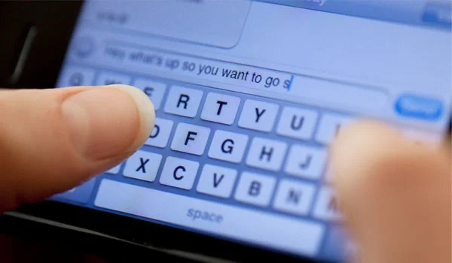
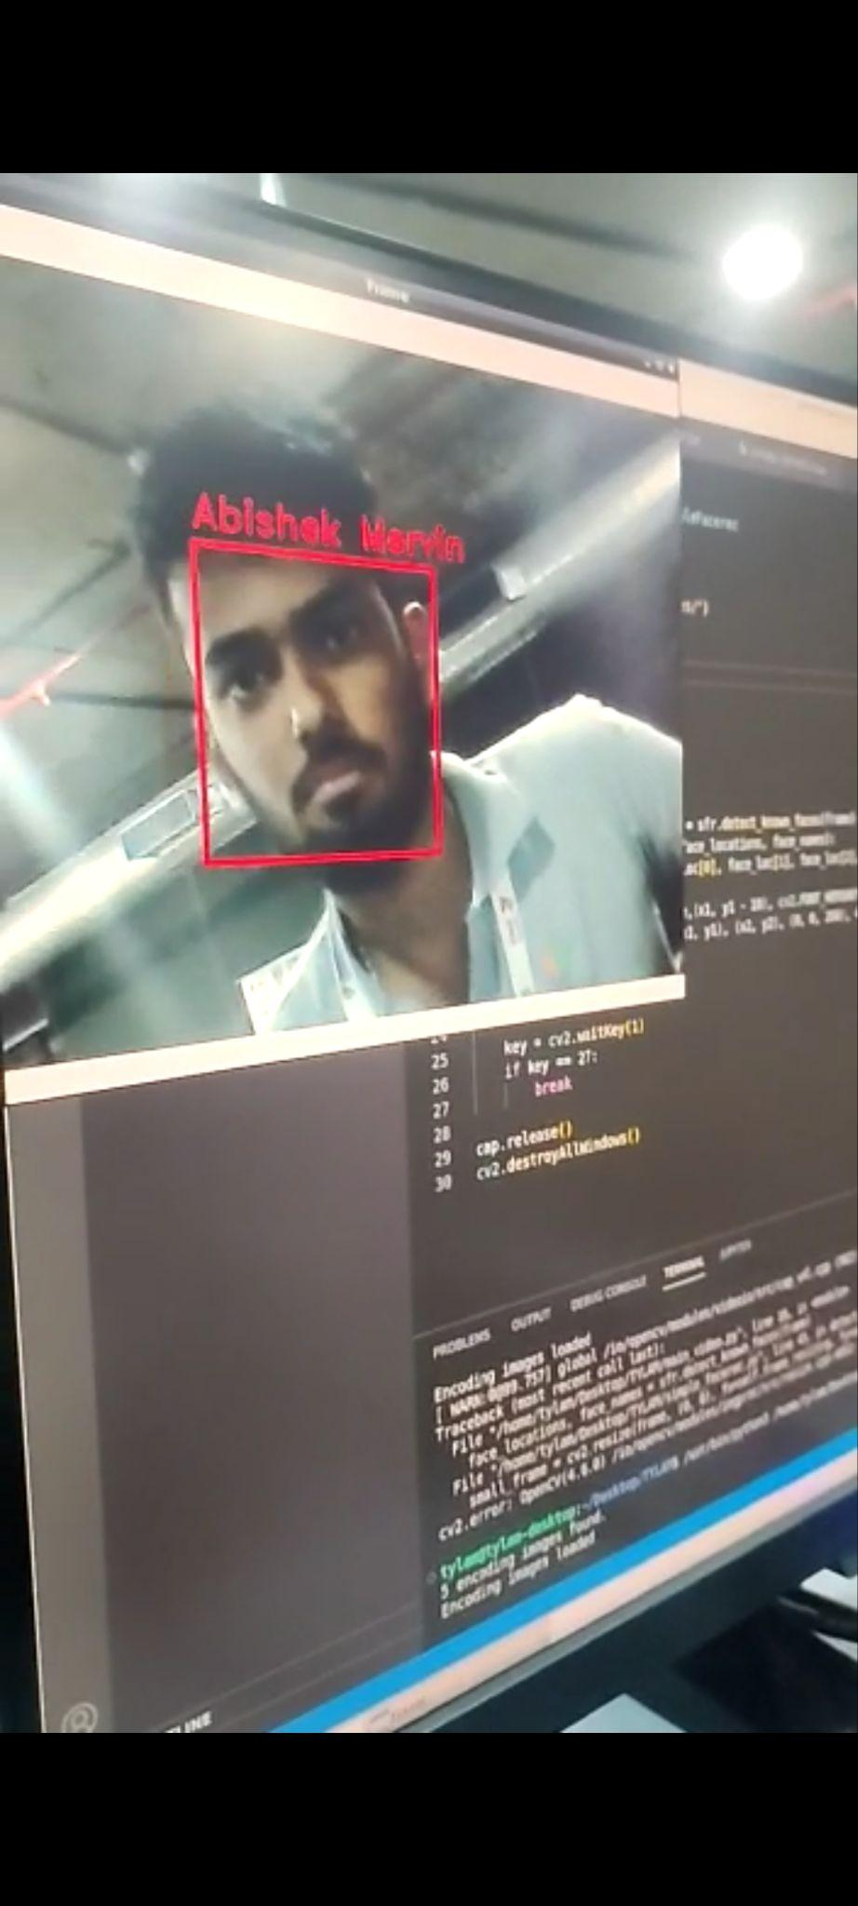

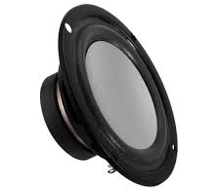

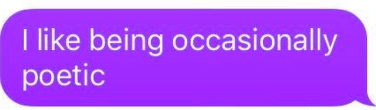
SOLUTION
PERSON WITH HEARING IMPAIRMENT
PERSON WITH SPEECH IMPAIRMENT
PERSON WITH VISUAL IMPAIRMENT
Speech Input
Text Input
Audio
Output
Text Output
Audio
Output

Slide 4
PERSON WITH VISUAL IMPAIRMENT

Slide 5
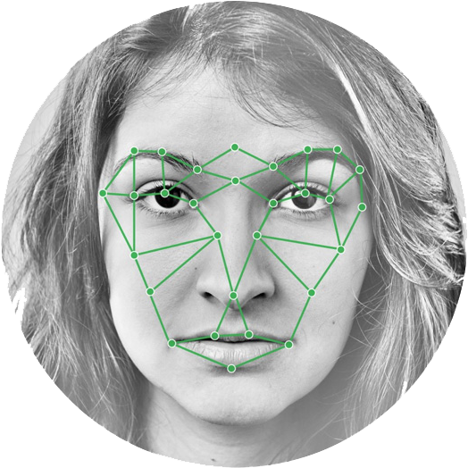
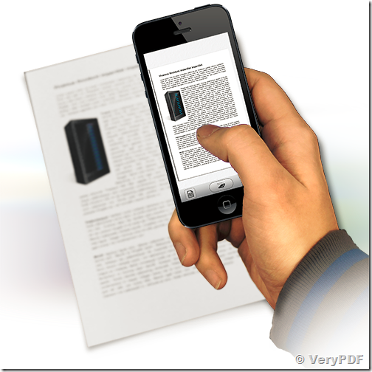
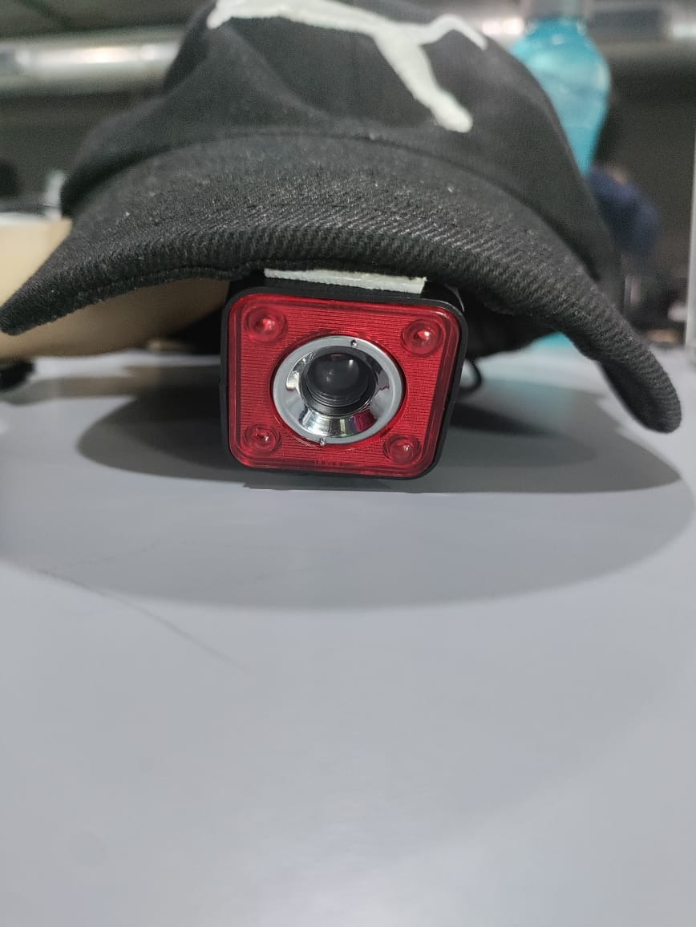
USE CASES
Optical Character Recognition
Facial
Recognition

Slide 6
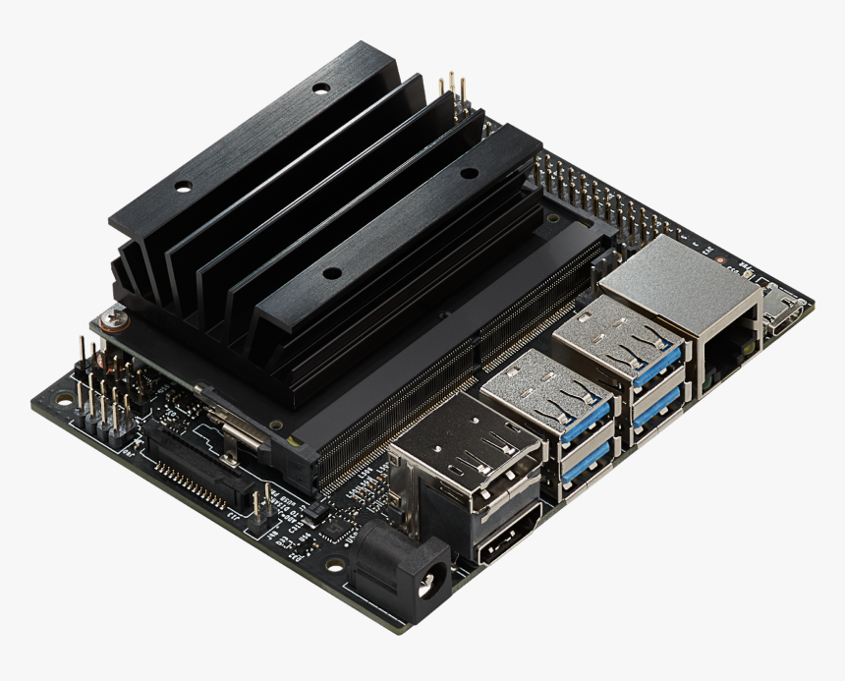
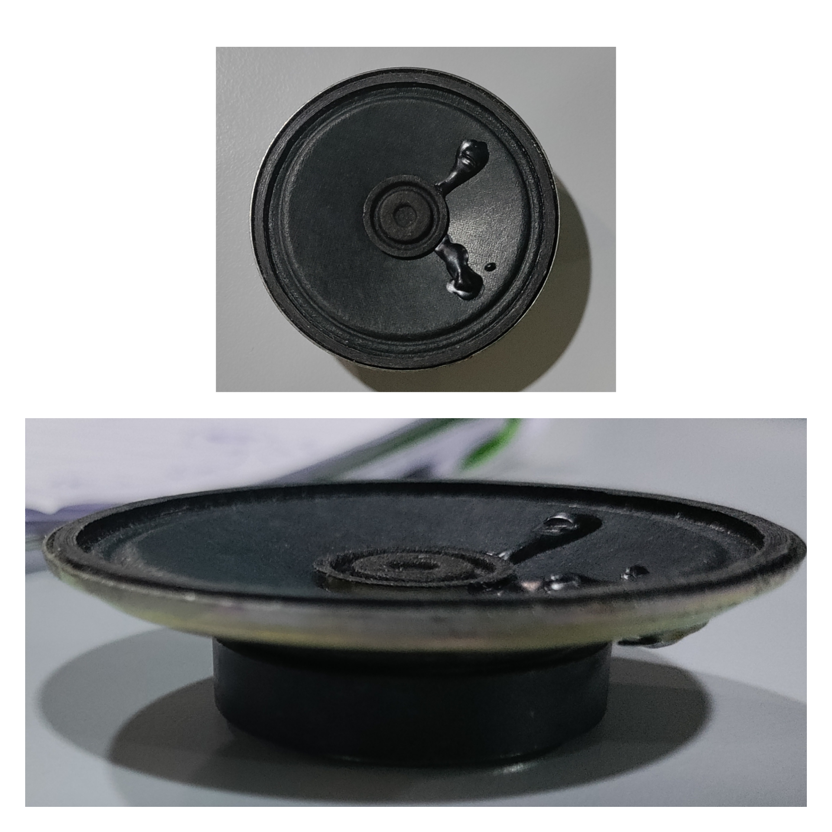
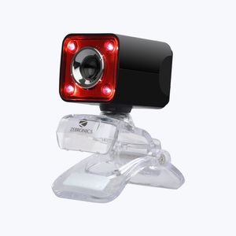
TECHNOLOGY STACK
JETSON NANO
SPEAKER 5V
ZEBRONICS WEB CAMERA
MEMORY: 4 GB 64-bit LPDDR4 1600MHz - 25.6 GB/s
CPU: Quad-core ARM Cortex-A57 MPCore processor
GPU: 128-core NVIDIA Maxwell
640x480 video resolution
Auto white balance
Manual Switch for LED
Full range audio speaker
2 inch
4 ohm 3 watt output

Slide 7
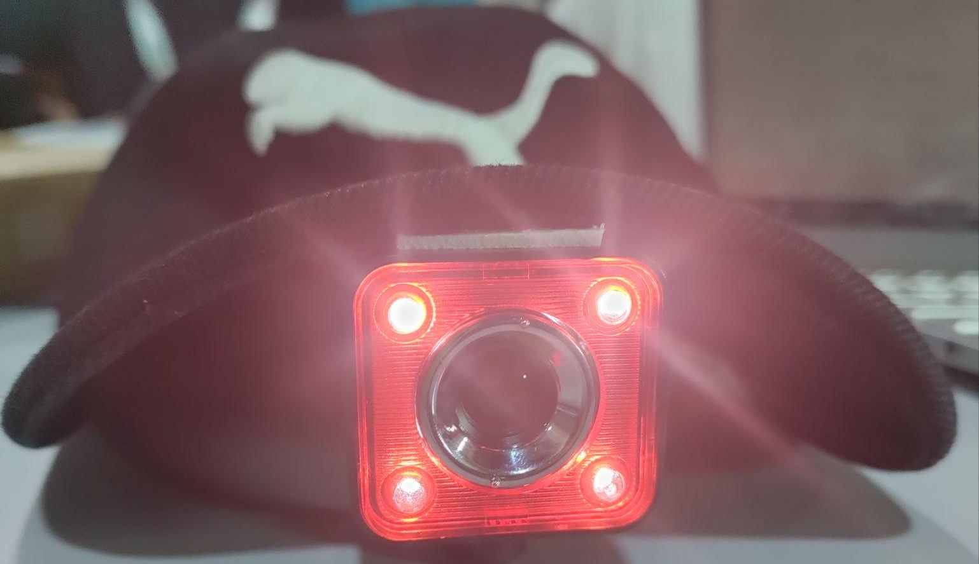

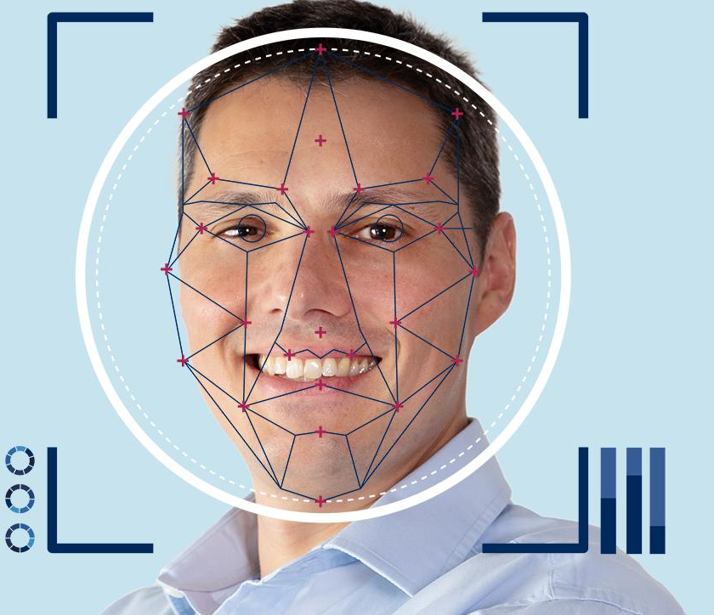
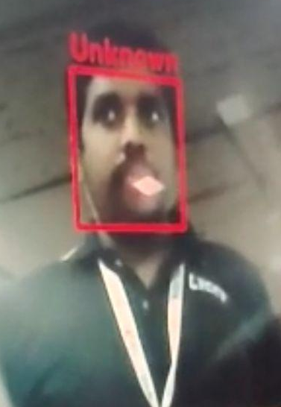
MODUS OPERANDI
Known face
[ON]
Chest piece
Audio
Unknown face
Libraries

Slide 8
HEARING IMPAIRED AND
MUTE PERSON

Slide 9


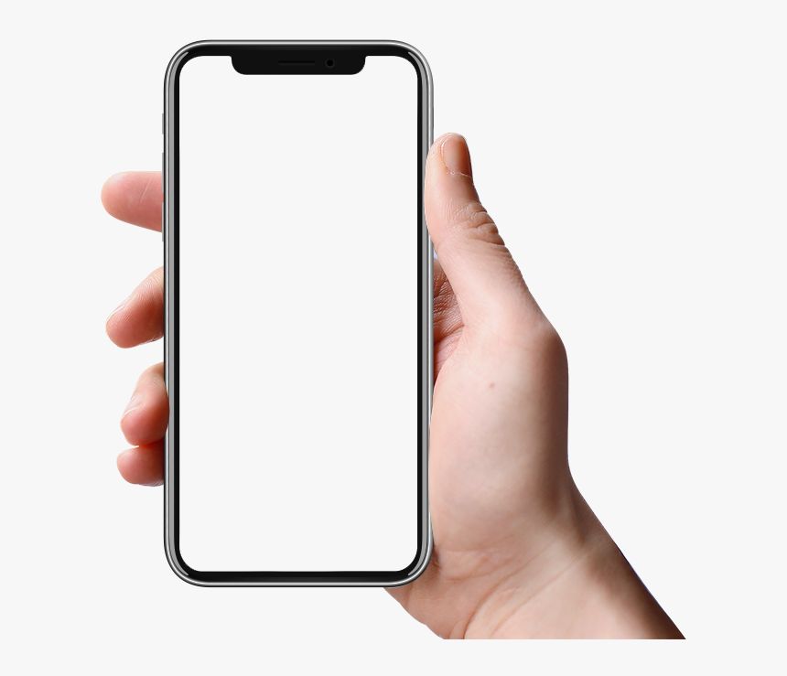
USE CASES
Speech
To
Text
Text
To
Voice

Slide 10

TECHNOLOGY STACK

Slide 11
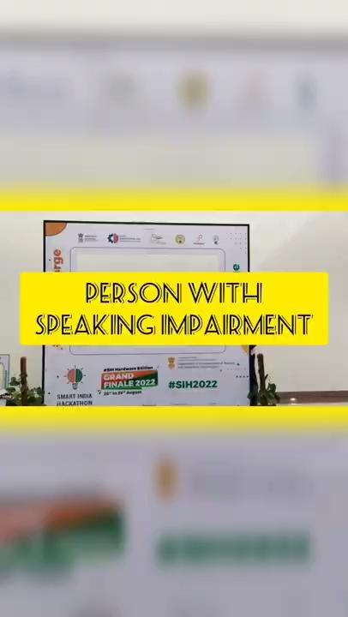

Slide 12
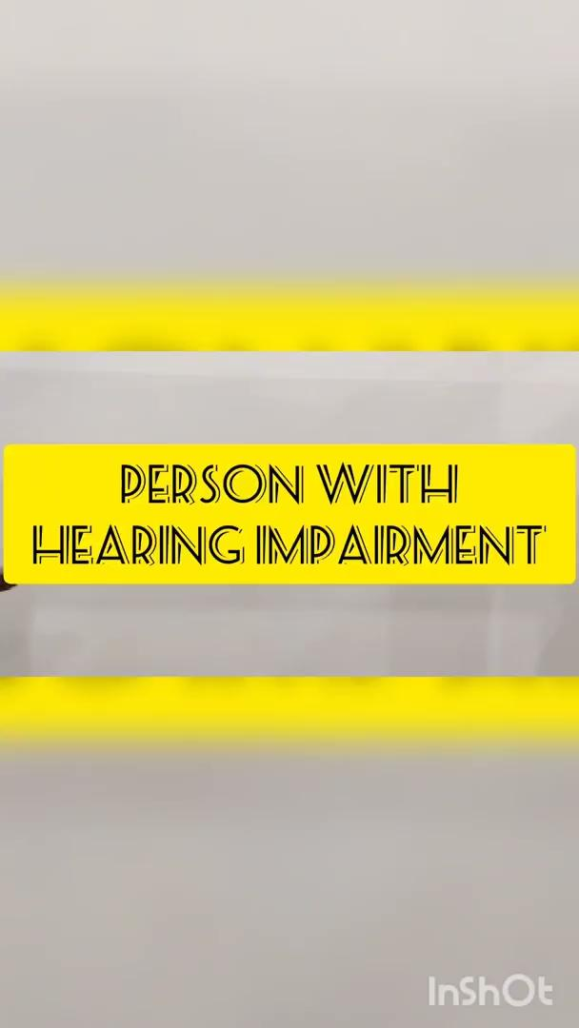

Slide 13
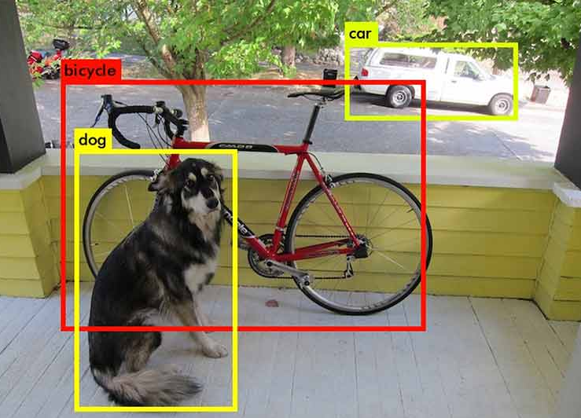

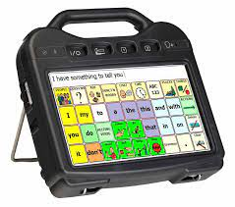
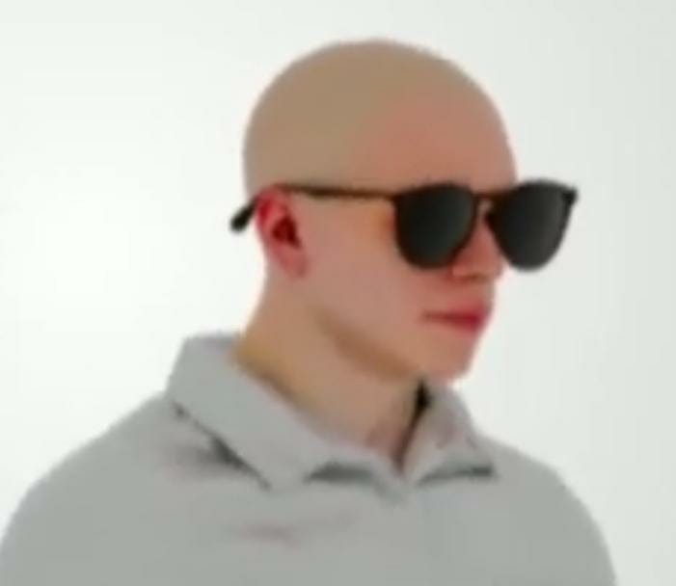
FUTURE ENHANCEMENTS
Augmentative &
Alternative
Communication
Object Detection
Bot
Assistance
Smart
Glass

Slide 14
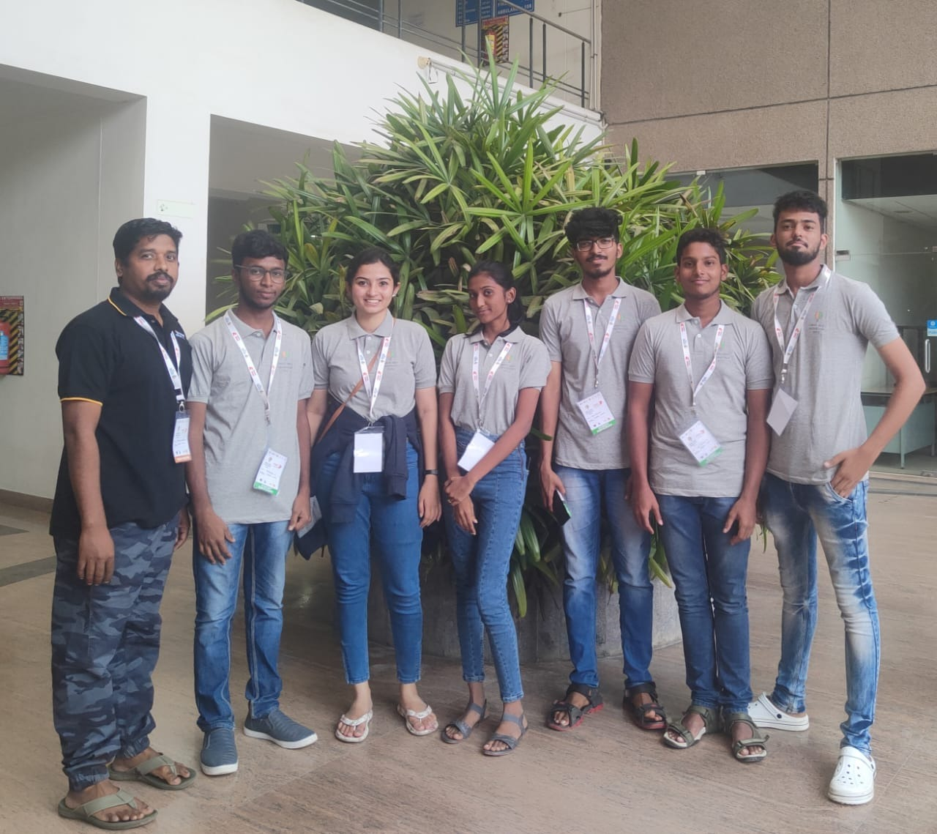
THANK YOU!
LOYOLA-ICAM COLLEGE OF ENGINEERING AND TECHNOLOGY
MR.MAHIMAI DON BOSCO F P (MENTOR)
YOGARAJAN J (TEAM LEADER)
ABISHEK MERVIN J
ASHIKA MARIYA R
LINNET A S
LEO WILLIAM G
MAHIZHAN A

Slide 15
ANY QUESTIONS?

